Slide 1
Image Caption Generator
J – Component Review – DIGITAL IMAGE PROCESSING
Done by:
Karthikeyan S 20MIS1065
Karthikeyan R 20MIS1122

Slide 2
MOTIVATION
Aid to the Blind - We can create a product for the blind which will guide them travelling on the roads without the support of anyone else.
Self Driving Cars - Automatic driving is one of the biggest challenges and if we can properly caption the scene around the car, it can give a boost to the self driving system.
Automatic Captioning can help, make Google Image Search as good as Google Search, as then every image could be first converted into a caption and then search can be performed based on the caption.

Slide 3
INTRODUCTION
In this project, we use CNN and LSTM to identify the caption of the image.
As the deep learning techniques are growing, huge datasets and computer power are helpful to make models that can generate captions for an image.
Image caption generator is a process which involves natural language processing and computer vision concepts to recognize the context of an image and present it in English.

Slide 4
LITERATURE REVIEW
Title | Year of Publication | Objectives | Techniques Used | Dataset
Camera2Caption: A Real-Time Image Caption Generator | 2017 | Simplistic encoder and decoder to produce real-time captions for the image | CNN RNN LSTM | MSCOCO (2014) 82780 images
Building A Voice Based Image Caption Generator with Deep Learning | 2021 | Voice based captions for an input image | CNN LSTM | Flickr_8k
Explainable Image Caption Generator Using Attention and Bayesian Inference | 2018 | Explain the caption generated without using encoder and decoder model | CNN LSTM RNN | Flickr_8k Flickr_30k MSCOCO

Slide 5
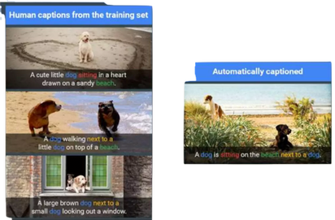
OBJECTIVE
To develop a system for users which can automatically generate the description of an image with the use of CNN along with LSTM.

Slide 6
PROPOSED METHODS
Algorithms:
CNN – Convolutional Neural Network
LSTM – Long – Short Term Memory
Datasets:
Flickr_8k_Dataset
Flickr_8k_Text

Slide 7
CNN – Convolutional Neural Network
CNN is a type of Artificial Neural Network, which takes in an input image, extract features (learnable weights and biases) from various aspects/objects in the image and be able to differentiate one from the other.
Image classification and identification can be easily done using CNN.
It can determine whether an image is a dog, a bird or a plane, etc.

Slide 8
VGG16 Model
VGG-16 is a convolutional neural network that is 16 layers deep.
You can load a pretrained version of the network trained on more than a million images from the ImageNet database.
The pretrained network can classify images into 1000 object categories, such as keyboard, mouse, pencil, and many animals.

Slide 9
LSTM – Long-Short Term Memory
LSTM are type of RNN (Recurrent Neural Network) which is well suited for sequence prediction problems.
We can predict what the next words will be based on the previous text.
LSTM can carry out relevant information throughout the processing, it discards non-relevant information.

Slide 10
PROPOSED MODEL

Slide 11
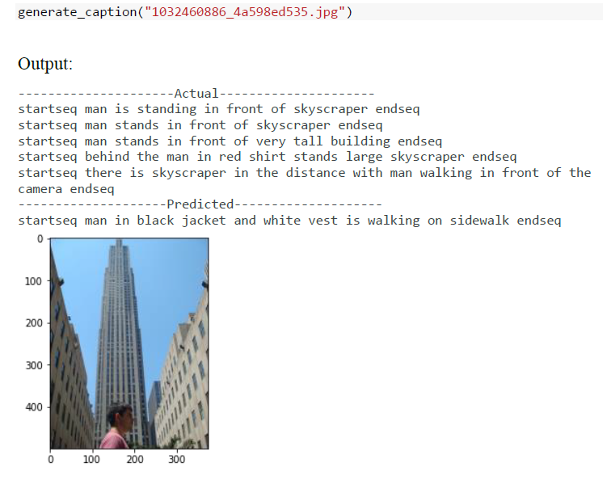
RESULT

Slide 12
APPLICATIONS
Google Photos – To categorize photos into pets, mountains, etc.
Can be used to aid the visually impaired by offering a computer-generated spoken voice that would “read” text to the user.

Slide 13
List Of References Used
V. Agrawal, S. Dhekane, N. Tuniya and V. Vyas, "Image Caption Generator Using Attention Mechanism," 2021 12th International Conference on Computing Communication and Networking Technologies (ICCCNT), 2021, pp. 1-6, doi: 10.1109/ICCCNT51525.2021.9579967.
P. Mathur, A. Gill, A. Yadav, A. Mishra and N. K. Bansode, "Camera2Caption: A real-time image caption generator," 2017 International Conference on Computational Intelligence in Data Science(ICCIDS), 2017, pp. 1-6, doi: 10.1109/ICCIDS.2017.8272660.
M. P. R, M. Anu and D. S, "Building A Voice Based Image Caption Generator with Deep Learning," 2021 5th International Conference on Intelligent Computing and Control Systems (ICICCS), 2021, pp. 943-948, doi: 10.1109/ICICCS51141.2021.9432091.
S. -H. Han and H. -J. Choi, "Explainable Image Caption Generator Using Attention and Bayesian Inference," 2018 International Conference on Computational Science and Computational Intelligence (CSCI), 2018, pp. 478-481, doi: 10.1109/CSCI46756.2018.00098.
A. Singh and D. Vij, "CNN-LSTM based Social Media Post Caption Generator," 2022 2nd International Conference on Innovative Practices in Technology and Management (ICIPTM), 2022, pp. 205-209, doi: 10.1109/ICIPTM54933.2022.9754189.

